Slide 1
Integrating living faith with your practice
Dr. Bill Morehouse
His Branches Health Services, Rochester, NY

Slide 2
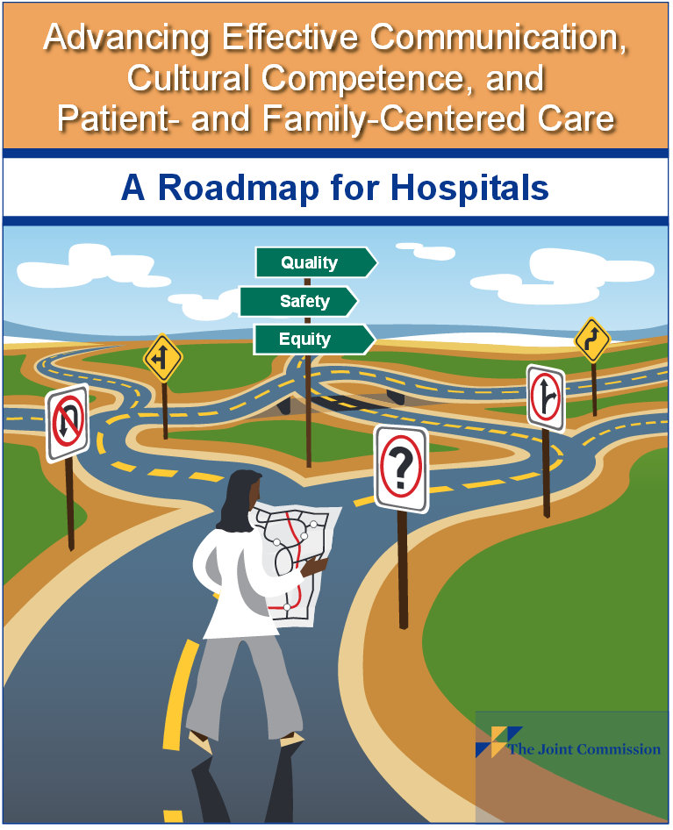
Joint Commission Mandate
The Joint Commission requires organizations to include a spiritual assessment as part of the overall assessment of a patient to determine how the patient’s spiritual outlook can affect his or her care, treatment, and services. This assessment should also determine whether more in-depth assessments are necessary.
While the Joint Commission leaves the specifics to each organization, spiritual assessment should, at a minimum, determine the patient’s religious affiliation (if any), as well as any beliefs or spiritual practices that are important to the patient.

Slide 3
Mankind in community
How we relate to ourselves and others
Individual – with God and self
Family – with natural and adoptive members
Neighborhood – with those in immediate surroundings
Ethnic – with those of kindred language and culture
Kingdom/Nation – with those following same governance
Humanity – with all of mankind throughout the world

Slide 4
Tripartite Nature of Human Life
Body - Soma
Physical, somatic, tangible
Soul – Psyche
Self, heart, feelings, experiences
Spirit – Pneumo
Thought life, inspiration
Energy Balance idea

Slide 5
Biopsychosocial Model
Pioneered in Rochester by Drs. Engel (Internal Medicine) and Romano (Psych)
Eclipsed determinist biophysical model that had increasingly dominated post WWII medicine
Divides human life along Greek philosophical lines into Body (bio) and Soul (psychosocial)
When “spirituality” is addressed it is as a manifestation of the psychosocial dynamic, not as a separate sphere – e.g., talking to yourself

Slide 6
Biopsychosocial-spiritual Model
Each sphere is addressed definitively but as part of a larger integrated whole that is greater than the sum of its parts
Spiritual life is recognized as a dimension of reality separate from but integrated with the other two
“For the word of God is alive and active. Sharper than any double-edged sword, it penetrates even to dividing soul and spirit, joints and marrow; it judges the thoughts and attitudes of the heart.”
Hebrews 4.12

Slide 7
Pressures that are on us
From without
From within
Daily workload
Family and friends/associates
Professional and Academic peers
Community standards
“Political Correctness”
The Zeitgeist
Time constraints
Concern about patient reaction
Concern about competence
Concern about reputation
Concern about ethics
Faceless anxiety

Slide 8
Zeitgeist
The Zeitgeist (spirit of the age or spirit of the time) is the intellectual fashion or dominant school of thought that typifies and influences the culture of a particular period in time.
Wikipedia

Slide 9
Zeitgeist = the Big Bad PC Wolf
A broad-based, widely-spread spiritual influence that is orchestrated by “the prince of the power of the air… the spirit that is now working in the sons of disobedience.”

Slide 10
Spirit of the antichrist
“Every spirit that does not confess Jesus is not from God; this is the spirit of the antichrist, of which you have heard that it is coming, and now it is already in the world. You are from God, little children, and have overcome them; because greater is He who is in you than he who is in the world. They are from the world; therefore they speak as from the world, and the world listens to them. We are from God; he who knows God listens to us; he who is not from God does not listen to us.”
1 John 4.3-6

Slide 11
Life and Death
“And you were dead in your trespasses and sins, in which you formerly walked according to the course of this world, according to the prince of the power of the air, of the spirit that is now working in the sons of disobedience. Among them we too all formerly lived in the lusts of our flesh, indulging the desires of the flesh and of the mind, and were by nature children of wrath, even as the rest. But God, being rich in mercy, because of His great love with which He loved us, even when we were dead in our transgressions, made us alive together with Christ (by grace you have been saved), and raised us up with Him, and seated us with Him in the heavenly places in Christ Jesus, so that in the ages to come He might show the surpassing riches of His grace in kindness toward us in Christ Jesus. For by grace you have been saved through faith; and that not of yourselves, it is the gift of God; not as a result of works, so that no one may boast. For we are His workmanship, created in Christ Jesus for good works, which God prepared beforehand so that we would walk in them.”
Ephesians 2.1-10

Slide 12
Back to JCAHO
“The Joint Commission requires organizations to include a spiritual assessment as part of the overall assessment of a patient to determine how the patient’s spiritual outlook can affect his or her care, treatment, and services. This assessment should also determine whether more in-depth assessments are necessary.”
We’re called to become experts and leaders in this area of the healing arts, which is the “care” part of medical care, the “art” of medicine.

Slide 13
OK, how do we do it?
Guiding Premises:
We follow Jesus’ example, since He is the Way, the Truth, and the Life.
We understand that when any person comes to know the truth, the truth progressively sets them free.
Therefore:
We share the truth with people about their situations and God’s love as we reach across and come to know them better.
We do it in the right way by “speaking the truth in love” and modeling exemplary tone, attitude, speech, and behavior.
And we look for, promote, and anticipate “life and life in abundance” as the progressive outcome.

Slide 14
Let’s get to know people
Body, Soul, and Spirit
We pretty much know how to do the “body” part…
We need to get to know them personally – the “soul” part - who they are, what they do, who they are related to, how they think, feel, and act. What is important to them, motivates them, inhibits them.
And we’re invited by JCAHO and the Holy Spirit to get to know them better spiritually – what are their hopes and fears, where do they feel weak, what are their sources of strength, do they believe in prayer, where is God in their lives and current situations, why do they think they are ill, have they found support in a faith community, etc.

Slide 15
Being living letters
Living
Being alive, lively, active, engaged, interactive, accessible, transparent, perky
Opposite: dead, dreary, sullen, withdrawn, aloof, inaccessible, opaque, drab
Letters
Sharing in language with God-breathed personal content that communicates with others
Opposite: being “closed books” without content that others can’t “read” or wouldn’t want to

Slide 16
Our manner
Being genuine ladies and gentlemen who are
Courteous and kind – always aware that “a soft word turns away wrath”
Cheerful – remembering that “a merry heart does good like a medicine”
Comforting – being available through empathetic listening to offer prayer and provide genuine support
Faithful and Hopeful – confidently sharing prophetic vision of a positive future planned and guided by a loving God
Loving – recognizing that caring is often best expressed in the details because “he who is faithful in little things is faithful also in great”

Slide 17
Details
Be 100% available to each person, one at a time
Greet people warmly, graciously, courteously
Ask about their welfare
Comment on something attractive or interesting about them, their hair, clothing, facial expression, companion
Mix humor and lightheartedness into your conversation
Allow space for personal anecdotes if they relate
Don’t let the world (EMR, schedule, to do list, unfinished charts and messages, politics, news, etc.) clutter you up or get you down

Slide 18
Being observant
Watch for nonverbal cues about underlying issues
Ask what brought them to you, then draw them out
Look for underlying motives beneath superficial reasons
Be sensitive to metacommunication, body language
Mix empathy with lightheartedness when probing into potentially painful subjects – “this is such a bad situation you have to either laugh or cry, or both…”
Don’t be afraid to dig around and ask personal questions – people are unusually receptive to someone who cares
Take note but don’t think you have to do something about everything you uncover

Slide 19
The Exam
Many of us are privileged to “lay hands on” people
Don’t be afraid to touch people appropriately
Do a good examination
Be warm but professional, firm but gentle
Check things that will confirm that you care enough to be thorough
Describe what you’re doing and what you’re finding as you go along
Keep up your personal conversation, weaving in pertinent spiritual inquiry and comment along the way

Slide 20
The faith connection
People come to us with bad news. We need to be prepared and able to share good news with them.
Be gentle but bold
Don’t be afraid to wear your Christian heart on your sleeve – “God bless you!”
Don’t be ashamed of the Gospel “for it is the power of God for salvation to everyone who believes”
Don’t hide your light under a bushel but put it on a lampstand
Be disciplined – it’s the mark of a disciple
Let the Holy Spirit be your guide
Offer to pray… and then pray openly, then and there

