Slide 1

Light and Life: Being living letters in a post-Christian world
October 17, 2015
Science, Faith and Health Care:
Unapologetic Apologetics for the Health Care Professional
William T. Griffin, DDS
Yorktown, VA

Slide 2
Science, Faith and Health Care:
Unapologetic Apologetics for the Health Care Provider
The Nature of Truth
Science and Faith
Faith and Health Care
Sharing Faith With Our Patients
Notes:
Science and Faith
Faith and Health Care
-At the end of each section there will be an opportunity for questions or comments.
*** If this presentation were a football game, you could say that I have elected to kick off – to begin by playing defense, seeking to stop the opposition’s attack, and then put some points on the board for our side.
*** but first, a bit of epistemology

Slide 3
Science and Faith:
Unapologetic Apologetics in Health Care
The Nature of Truth
Science and Faith
Faith and Health Care
Sharing Faith With Our Patients
Notes:
-truth is pretty important…
-no absolute truth???
-we are all searching for truth all of the time
-rarely, if ever, do we consider the processes by which we do this

Slide 4
The Nature of Truth
Two approaches to acquiring truth:
1. Empirically derived information
2. Information received from a
credible source
Notes:
– observations and experiences in our lives, and that which we can learn from others
#2 – i.e.- Who Wants to be a Millionare – figure if out yourself, or “phone a friend.”

Slide 5
The Nature of Truth
1. Empirically derived information
2. Information received from a credible
source
Q. Which can help us discover truth?
Q. Which can mislead us?
Q. Which approach is more reliable?
Notes:
Examples:
1- scientific method
2-directions – no problemon!

Slide 6
The Nature of Truth
Potential Issues with the Empirical Derivation of Truth:
Is my sample size big enough?
Have I correctly interpreted the data?
Is my conclusion applicable to alternative conditions?
Will it still be true in 50 years? 500 years?
Notes:
-This is why we constantly read articles that begin, “Science now believes…”

Slide 7
The Nature of Truth
Potential issues with information received from a credible source:
Q. Is the source really credible?

Slide 8
The Nature of Truth
Q. Is the source really credible?
Is Jesus Christ really who He claimed to be?
Is the Bible really the Word of God?
Notes:
As applied to Christianity, the question, “Is the source really credible?” becomes…
*** These may be the two most important questions we will ever consider!

Slide 9
The Nature of Truth
Two Sources of God’s Revelation:
General Revelation (God’s Creation)
Special Revelation (God’s Word, the Bible) - speaks to every area of life in an authoritative way
Notes:
General and Special Revelation – somewhat analogous to the two ways of searching for truth described earlier
General Revelation: All that God has created, including us.
Special Revelation: The Scriptures of the Old and New Testaments
-The Scriptures claim to be true, and they claim to be authoritative.
2 Tim 3:16 - All Scripture is inspired by God and profitable for teaching, for reproof, for correction, for training in righteousness; so that the man of God may be adequate, equipped for every good work.
Psalm 119:105 – Your word is a lamp to my feet and a light to my path.
John 17:17 – Sanctify me in the truth; your word is truth.

Slide 10
The Nature of Truth
Q. Do we really need more than
General Revelation
(empirically derived truth)?
Standards of morality
Understanding the nature of love
Basis for human dignity
Origin of man
Ultimate purpose of man
Our final destination
Ultimate justice

Slide 11
Q. Do we really need more than
General Revelation?
“There are problems to whose solution I would attach an infinitely greater importance than to those of mathematics, for example touching ethics, or our relation to God, or concerning our destiny and our future; but their solution lies wholly beyond us and completely outside the province of science.”
C.F. Gauss (1777-1855)
Notes:
C F Gauss, mathematician – early discoveries leading to the study of Algebra. Considered, along with Archimedes and Isaac Newton, to be one of the 3 greatest mathematicians of all time.

Slide 12
The Nature of Truth
“I said to myself, “Behold, I have magnified and increased wisdom more than all who were over Jerusalem before me; and my mind has observed a wealth of wisdom and knowledge. And I set my mind to know wisdom and to know madness and folly; I realized that this also is striving after wind. Because in much wisdom there is much grief, and increasing knowledge results in increasing pain.
Solomon – Proverbs 1:16-18
Notes:
Q. Try restating what Solomon has written here, in terms of General and Special Revelation

Slide 13
The Nature of Truth
“…while we look not at the things which are seen, but at the things which are not seen; for the things which are seen are temporal, but the things which are not seen are eternal.”
2 Corinthians 4:18
Notes:
General Revelation – what is seen – everyone has access to this source of truth
Special Revelation – what is not seen – received by faith
That which we know by faith, as communicated in the scriptures of the old and new testaments, is NOT second-rate truth!!!

Slide 14
The Nature of Truth
Question for Atheists:
Is General Revelation (Empirical Knowledge) enough to give life meaning and purpose?
Notes:
-All truth is God’s truth
-The Scriptures of the Old and New Testaments are to be the grid, the framework, through which we observe and experience life.

Slide 15
The Nature of Truth
Question for Christians:
Which source of truth predominates in your life, General Revelation or Special Revelation?
Notes:
-All truth is God’s truth
-The Scriptures of the Old and New Testaments are to be the grid, the framework, through which we observe and experience life.

Slide 16
The Nature of Truth
Questions?
Comments?

Slide 17

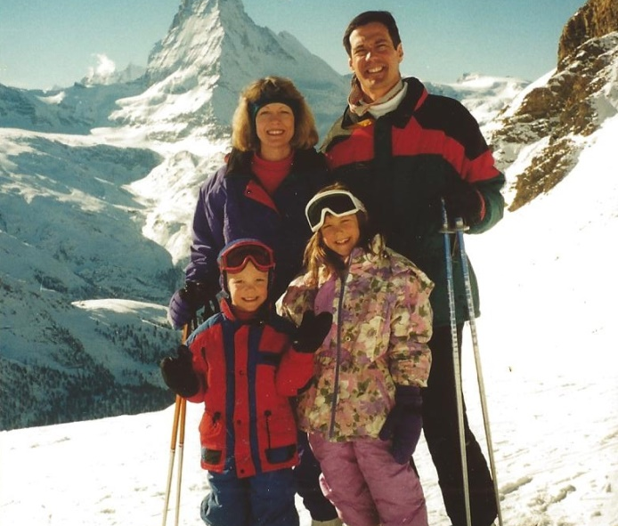
Family Skiing

Slide 18
Science and Faith:
Unapologetic Apologetics in Health Care
The Nature of Truth
Science and Faith
Biblical Basis for Health Care Providers
Sharing Faith With Our Patients
Notes:
In our first section we have cracked the door open a bit to the discussion of Science and Faith. Now let’s walk through that door.

Slide 19
Science and Faith
Important topic for all health care providers
  A. Perceived wall of separation
  B. How do we integrate our faith into our profession?
  C. How can we engage the unbelieving world?

Slide 20
Science and Faith
Everyone “does science,” attempting to learn from their life experiences
Everyone has faith in unprovable things; everyone has supra-logical assumptions on which they hang their “facts.” (Presuppositions)
Notes:
False Dichotomy, easy to illustrate, even to the non-Christian.

Slide 21
Science and Faith
Q. Which Faith?
A. Christianity
Notes:
-The Best
-Each person should believe they have found “the best”
-Aren’t all religions pretty much the same? Insult to people of all religions
-If I find a better one, I’m switching… ☺

Slide 22
Science and Faith
Q. According to the Scriptures of the Old and New Testaments, how do we know there is a God?

Slide 23
Science and Faith
Q. According to the Scriptures of the Old and New Testaments, how do we know there is a God?
All that He has made
General Revelation

Slide 24
Science and Faith
“The heavens are telling of the glory of God; and their expanse is declaring the work of His hands. Day to day pours forth speech, and night to night reveals knowledge.”
Psalms 19:1,2

Slide 25
Science and Faith
“…that which is known about God is evident within them; for God made it evident to them. For since the creation of the world His invisible attributes, His eternal power and divine nature, have been clearly seen, being understood through what has been made, so that they are without excuse.”
            Romans 1:19-20

Slide 26
Science and Faith
“This most beautiful system of the sun, planets, and comets, could only proceed from the counsel and dominion of an intelligent and powerful Being.”
Isaac Newton (1642-1727), Principia (1687)

Slide 27
Science and Faith
“Praise Him, sun and moon;
Praise Him, all stars of light!
Praise Him, highest heavens,
All the waters that are above the heavens!
Let them praise the name of the Lord,
For He commanded and they were created..”
Psalm 148:3-6
Notes:
Q. How does creation praise God?
A. Johannes Kepler

Slide 28
Science and Faith
“What voice has the heaven, what voice have the stars, to praise God as man does? Unless when they supply man with cause to praise God, they themselves are said to praise God.”
Johannes Kepler, Mathematician
(1571-1630)

Slide 29
Science and Faith
“As a believer, I see DNA, the information molecule of all living things, as God's language, and the elegance and complexity of our own bodies and the rest of nature as a reflection of God's plan.”
Dr. Francis Collins
Director, National Institutes of Health

Slide 30
Science and Faith
“To my God…the architect of the masticatory system. The more I understand the logic behind its beautifully integrated design, the more I realize its every element was planned by a loving creator. The words of affection that we speak, the smiles we share, the songs we sing, and the kisses we give to our loved ones are possible only because an element of love was integrated into this design.”
Dr. Peter Dawson, “Evaluation, Diagnosis and Treatment of Occlusal Problems,”

Slide 31
Science and Faith
Q. Why might a scientist (or
anyone else) deny God’s
existence?
Notes:
-Why is it that two people look at all that exists, and one concludes that there must be a God, while the other decides that there can’t be a God?

Slide 32
Science and Faith
Q. Why might a scientist (or
anyone else) deny God’s
existence?
A. They lie to themselves
Notes:
*** Anh – the question should come up, and then after another click, the answer should come up.
This is a strong allegation – to substantiate this claim, I would like to call two witnesses:

Slide 33
Science and Faith
“An honest man, armed with all knowledge available to us now, could only state that in some sense, the origin of life appears at the moment to be almost a miracle, so many are the conditions which would have had to have been satisfied to get it going.”
Francis Crick (Nobel prize for
his co-discovery of DNA)
(1916 – 2004)

Slide 34
Science and Faith
Q. Why might a scientist (or
anyone else) deny God’s
existence?
A. They “suppress the truth in unrighteousness”
The Apostle Paul
Romans 1:18

Slide 35
Science and Faith
“For the wrath of God is revealed from heaven against all ungodliness of men who suppress the truth in unrighteousness,”
Romans 1:18
Notes:
“Suppress the truth in unrighteousness” – let’s unpack this phrase a bit…

Slide 36
Science and Faith
“because that which is known about God is evident within them; for God made it evident to them.”
Romans 1:19

Slide 37
Science and Faith
“For since the creation of the world His invisible attributes, His eternal power and divine nature, have been clearly seen, being understood through what has been made, so that they are without excuse..”
Romans 1:20

Slide 38
Science and Faith
“For even though they knew God, they did not honor Him as God or give thanks, but they became futile in their speculations, and their foolish heart was darkened.”
Romans 1:21

Slide 39
Science and Faith
“The fool has said in his heart, ‘There is no God.’”
Psalms 14:1
Notes:
*** This is not meant to create a condescending attitude towards those who deny God’s existence, but it is meant to bring to light the fact that denying the Lord is not just unfortunate, it is also contrary to the evidence that exists.

Slide 40
Science and Faith
Q. Is the purpose of creation to merely convince us that there is a God???

Slide 41
Science and Faith
“Now, friendly reader, do not forget the end of all this, which is the conception, admiration and veneration of the Most Wise Maker. For it is nothing to have progressed from the eyes to the mind, from sight to contemplation, from the visible motion to the Creator’s most profound plan, if you are willing to rest there, and do not soar in a single bound and with complete dedication of spirit to knowledge, love and worship of the Creator…”
Johannes Kepler, Mathematician
(1571-1630)
Notes:
-Not just grudging acknowledgement that God exists, but a call to love and worship Him.

Slide 42
Science and Faith
“Let everything that has breath praise the Lord”
Psalm 150:6

Slide 43
Science and Faith
Q. How should science deal with the miraculous?
Notes:
*** Anh – first the question should come up, and then after another click the answer should come up.

Slide 44
Science and Faith
Q. How should science deal with the miraculous?
A. It can’t.
Notes:
*** Anh – first the question should come up, and then after another click the answer should come up.

Slide 45
Science and Faith
Q. The most famous, often-attacked miracle?
A. The resurrection of Jesus Christ
Q. Why do some reject it?

Slide 46
Science and Faith
The Resurrection of Jesus Christ
Q. Why do some reject it?
Most people who reject the resurrection have not done so because they examined
the evidence and found it lacking.
Rather, they do so because they
have categorically ruled out the
possibility of miracles.

Slide 47
Science and Faith
“Thus to dismiss, out of hand, something as untrue, simply because science can neither authenticate nor falsify it, is clearly a flawed way of searching for truth.”
Dr. David Doughty
Current Provost
Former Dean of Science
Christopher Newport University
Newport News, VA
Notes:
Talk by Dr. Dave Doughty, “The Resurrection of Christ, Did it Really Happen?”

Slide 48
Science and Faith
Q. What about the “God of the Gaps” Theory?
  We will NEVER understand it all!
  Understanding something does NOT equate to responsibility for it!
Notes:
Anh: let’s make each of these two points come in one at a time, with each click – first the question, then the first point, then the second point.

Slide 49
Science and Faith
  “I planted, Apollos watered, but God was causing the growth.”
            1 Cor 3:6
  “He is before all things, and in Him all things hold together.”
  Colossians 1:17

Slide 50
Science and Faith
Q. What about perceived
conflicts between General and
Special Revelation?
* Geocentric vs. Heliocentric
solar system
* How life began
A. No Final Conflict (Francis
Shaeffer)
Notes:
*** Anh – let’s first just show the question, then the first example, then the second example, then the answer.

Slide 51
Science and Faith
Q. “Scientific” Alternative to Faith?
“The cosmos is all that is or ever was or ever will be.”
Carl Sagan (1934-1996)
-Francis Crick’s theory of the Origin of Life
(Richard Dawkins agrees)

Slide 52
Science and Faith
John 20:19-29
Notes:
Q. Disciple that was missing when Jesus appeared.
-Didymus

Slide 53
Conclusion
“…and you will know the truth, and the truth will make you free.”
John 8:32
Notes:
*** Distinction between General and Special Revelation – which one sets us free???

Slide 54
Science and Faith
Questions?
Comments?
Notes:
Challenge: consider some of the scripture verses or passages that guide you, or should guide you, in your practice of health care.
-ND/Oklahoma Football Game

Slide 55
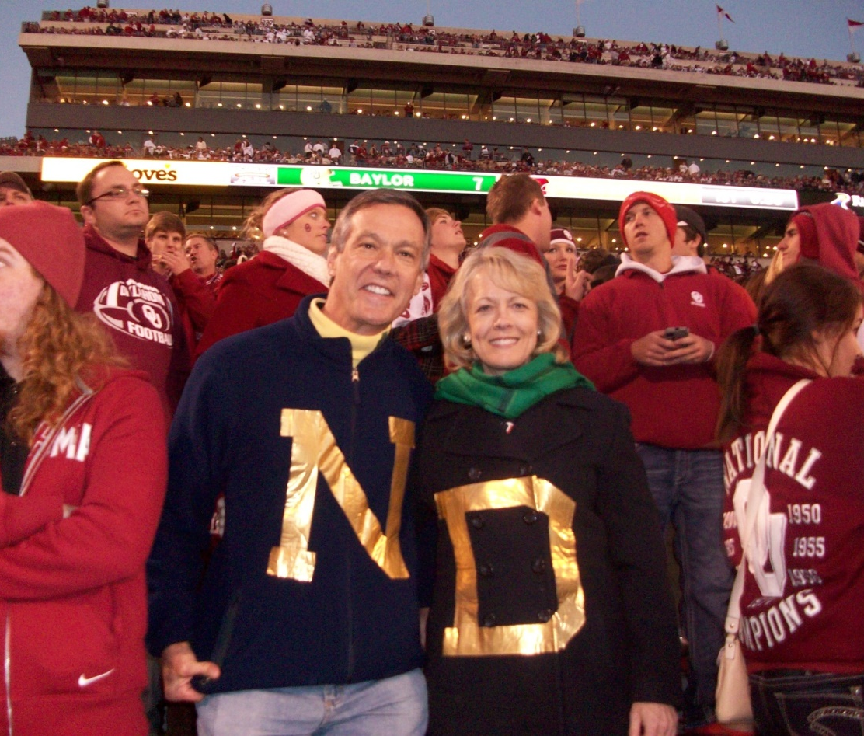
Notre Dame – Oklahoma Game

Slide 56
Science and Faith:
Unapologetic Apologetics in Health Care
The Nature of Truth
Science and Faith
Faith and Health Care
Sharing Faith With Our Patients

Slide 57
Faith and Health Care
“You are our letter, written in our hearts, known and read by all men; being manifested that you are a letter of Christ, cared for by us, written not with ink but with the Spirit of the living God, not tablets of stone but on tablets of human hearts.”
2 Corinthians 3:2-3
Notes:
-Incarnational Health Care
-If we are seeking to be excellent health care providers, and if the Lord is blessing our efforts with some degree of success, then our seeking to point to Him in our interaction with patients is merely to give credit where credit is rightly due.

Slide 58
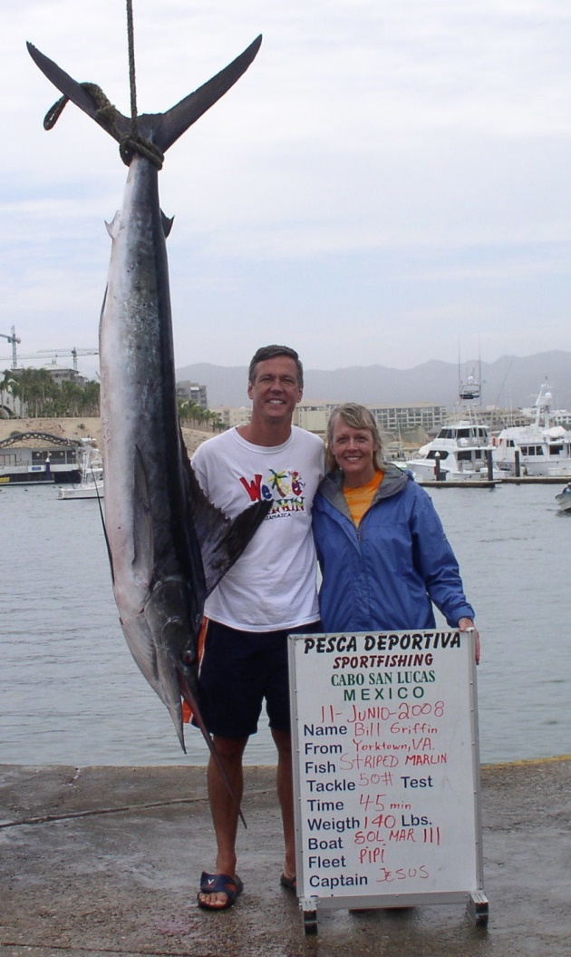

Slide 59
Science and Faith:
Unapologetic Apologetics in Health Care
The Nature of Truth
Science and Faith
Biblical Basis for Health Care Providers
Sharing Faith With Our Patients

Slide 60
Sharing Faith With Our Patients
Grace Prescriptions Course
(from CMDA)
Formerly known as The Saline Solution
Dr. Walt Larrimore and Bill Peel
Notes:
-New Video Series, hot off the press: going through it with a group of Chrisian doctors back home.

Slide 61
Sharing Faith With Our Patients
We have to learn to find the back door to people’s hearts, because the front door is heavily guarded.
Ravi Zacharias
Notes:
Q. How does this quote relate to the opportunity we have as health care practitioners???

Slide 62
Sharing Faith With Our Patients
“But sanctify Christ as Lord in your hearts, always being ready to make a defense to everyone who asks you to give an account for the hope that is in you, yet with gentleness and reverence.”
1 Peter 3:15
Notes:
Seek to offer excellent care, and render it with compassion – in our increasingly money-driven health care system, a Christ-driven compassionate attitude will stand out in your patients’ eyes.

Slide 63
Sharing Faith With Our Patients
Microdecisions of Faith
“I planted, Apollos watered, but God caused the growth.”
1 Corinthians 3:6
Notes:
Large chart, continuum of how someone hostile to the faith can, over time, be transformed into a Gospel-sharing Christian.
-See page 4 of handout.

Slide 64
Sharing Faith With Our Patients
Cultivating
Looks positively at the Bible
Recognizes difference in the messenger
Aware of the messenger
Going his/her own way
Avoids the truth
Notes:
In most patient populations these days, it is likely that there will be Christians with varying degrees of faith, and non-Christians with varying degrees of skepticism.

Slide 65
Sharing Faith With Our Patients
Sowing
Considers the truth of the
Gospel
Understands the implications
Aware of the Gospel
Recognizes relevance of the
Bible

Slide 66
Sharing Faith With Our Patients
Harvesting
Trusts in Christ
Turns from self-trust
Sees Christ as the answer
Recognizes spiritual need

Slide 67
Sharing Faith With Our Patients
Multiplying
Chooses to live by faith
Chooses to share faith
Makes Christlike Choices
Joins in community life
Assimilates God’s Word

Slide 68
Sharing Faith With Our Patients
Faith Flags – quick casual references that illustrate the fact that God, faith or the Bible are important to us.
Examples:
Notes:
You have been blessed with a healthy mouth, let’s keep it that way!
At a restaurant – server, offer to pray for him/her

Slide 69
Sharing Faith With Our Patients
Faith Stories – slightly longer illustrations of how the power of the Gospel is a blessing to us.
Examples:
Notes:
Like you, I am challenged at times by stress in my life. The best way I know of is to pray, to seek the Lord’s help. When I’m worrying, I am pretending as though everything depends on me. When I pray, I am acknowledging that only God’s shoulders are big enough for that role.
-Raising kids: My wife and I found a book that has been a huge help in the area of raising kids – but it’s about 2,000 years old, not even sure if it’s still in print… ☺
Marriage, Raising Kids, etc.

Slide 70
Sharing Faith With Our Patients
“Finally, brethren, whatever is true, whatever is honorable, whatever is right, whatever is pure, whatever is lovely, whatever is of good repute, if there is any excellence and if anything worthy of praise, dwell on these things”
Philippians 4:8,9
Notes:
We in health care are trained to recognize disease, deviations from “normal.” The apostle Paul calls us to recognize things that are excellent, praiseworthy.

Slide 71
Sharing Faith With Our Patients
Physical Resources:
  Health History Form
  World Magazine
  Today’s Christian Doctor
  Books in Waiting Room
  Steve Green DVD’s: Hide’em In Your Heart
  Dental Health/Spiritual Health Brochure

Slide 72
Sharing Faith With Our Patients
Crystal
Notes:
*** Anh – let’s include a copy of the article about Crystal in the handout that we prepare for the attendees.

Slide 73
Sharing Faith With Our Patients
“When I came (to your office), I wanted what you and the nurses had. Most other Christians that I came across knew a lot and preached to me, but there wasn’t that spark, that light that shined through when I entered this office. The love of God was through the whole office. I could definitely see that in everybody. I knew that it wasn’t just a dental office where it was only about dental health. I knew there was something more to it.”

Slide 74
Sharing Faith With Our Patients
“Unfortunately, it took me sitting in a jail cell to realize that I no longer could control my life. It wasn’t something I could do on my own any more… I knew that it was time to allow Jesus to be the leader of my life.”
Notes:
*** Anh – let’s include a copy of the article about Crystal in the handout that we prepare for the attendees.

Slide 75
Sharing Faith With Our Patients
Crystal’s Advice: “…let the light in them shine through… that warms even someone who is not a Christian… it warms their heart. I know they’ve got to feel it. So in everything that you do, do it so that it glorifies God. Then the love of God for others will shine through you, and even if your patient is angry, they will still see it and want it for themselves.”
Notes:
*** Anh – let’s include a copy of the article about Crystal in the handout that we prepare for the attendees.

Slide 76
Final Thought
But if I say, “I will not remember Him or speak anymore in His name,” then it my heart it becomes like a burning fire shut up in my bones; and I am weary of holding it in, and I cannot endure it.”
Notes:
*** Distinction between General and Special Revelation – which one sets us free???

Slide 77
Sharing Faith With Our Patients
Questions?
Comments?

