Slide 1
WOMEN OF HOPE San Pedro Sula, Honduras
Global Health Outreach Medical Mission Team
March 30-April 7, 2019

Slide 2
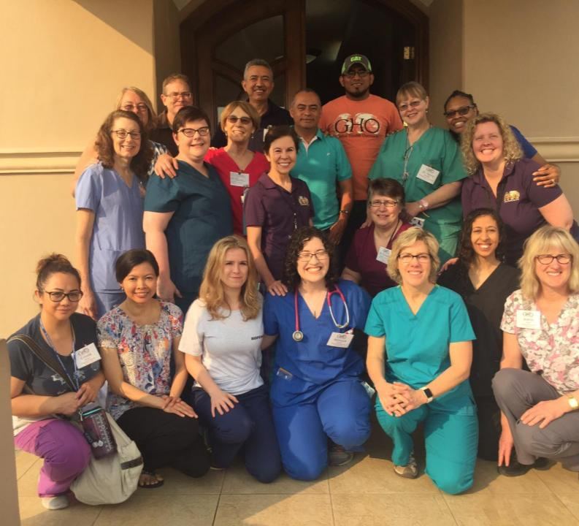
Our Team
16 Members from the Usa and Canada
1 Cytotechnologist, 1 Ultrasonographer, 1 Pharmacist, 1 Medical Student, 1 Physician Assistant, 1 Nurse Practitioner, 1 Family Medicine Resident, 1 Optician, 2 Logistics, 2 Nurses, 1 Ob-GYN, 1 ER Physician, 2 Family Physicians.

Slide 3
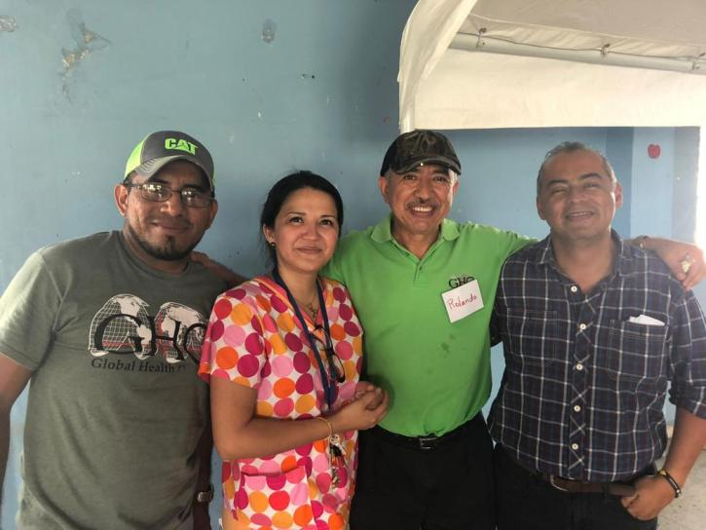
OUR HONDURAN & NICARAGUAN PARTNERS
ROY, Dr. Karen, Pastor Rolando and Pastor Melvin

Slide 4
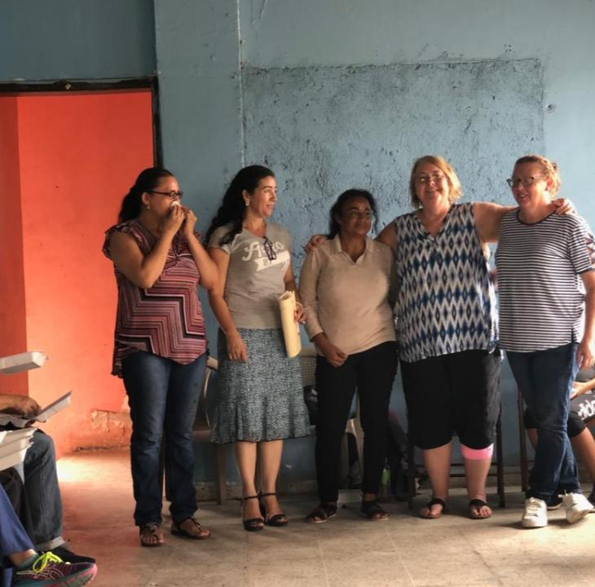
THE STAFF OF WOMEN OF HOPE
Nelsy, Mercedes, Susana, April (founder), Joy

Slide 5
WOMEN OF HOPE
The Ministry Provides Spiritual and Practical Help to women & Girls who are caught in the trap of Prostitution
Three times per week the women meet for Devotions and Discipleship programs.
In addition, the women receive vocational Training (Baking, sewing and Jewelry making)
There are monthly Evangelistic Outreach Meetings that are often led by women from HOH Nicaragua, who travel over 12 hours to share their Testimonies.

Slide 6
The Purpose of Our Mission Trip
To share Gospel
To screen this HIGH RISK population for Cervical Cancer, HIV & Syphilis, and treat them/refer them to local programs for ongoing care if needed.
To provide basic medical care to the women, their children and folks in neighborhood.
To offer ultrasounds to those who were pregnant
To do basic Eye refractions & Provide Glasses to patients

Slide 7
Our CLINIC

Slide 8
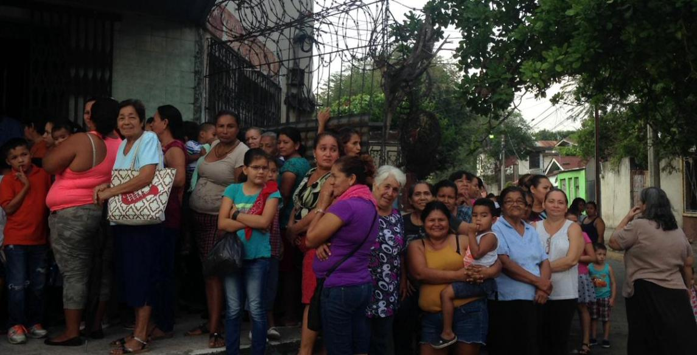

Slide 9
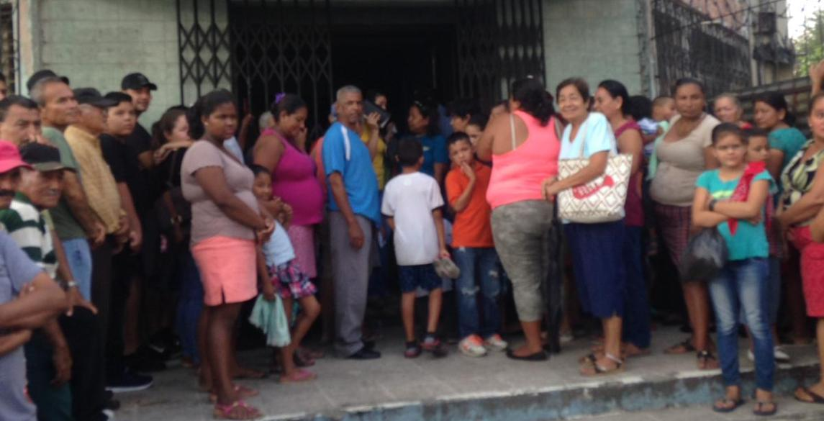

Slide 10
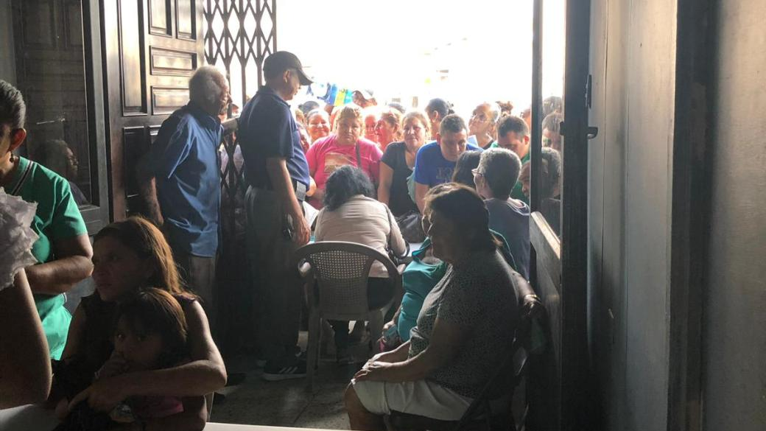

Slide 11
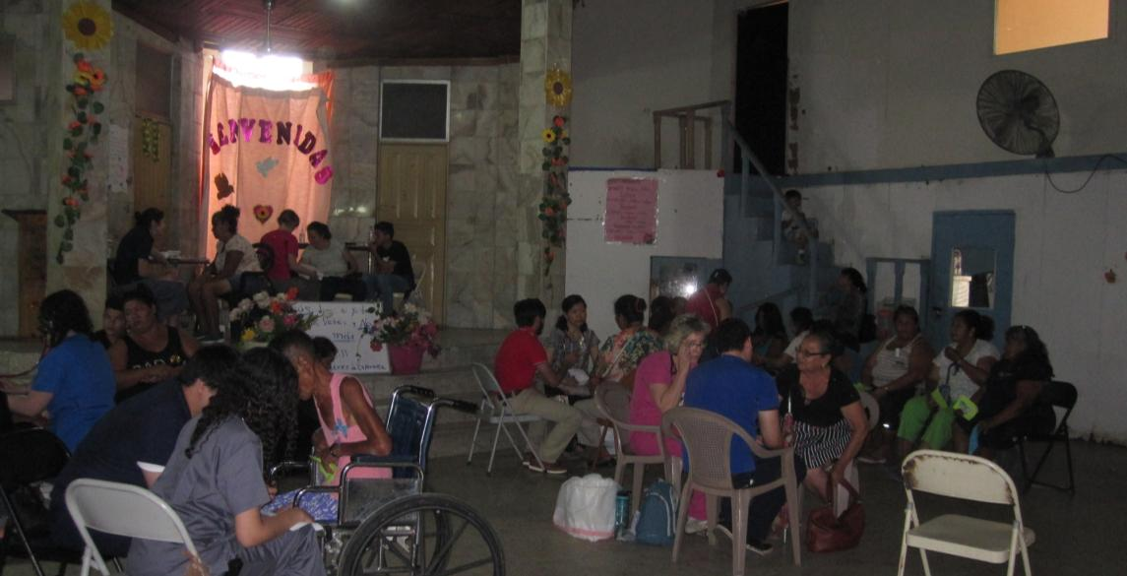

Slide 12
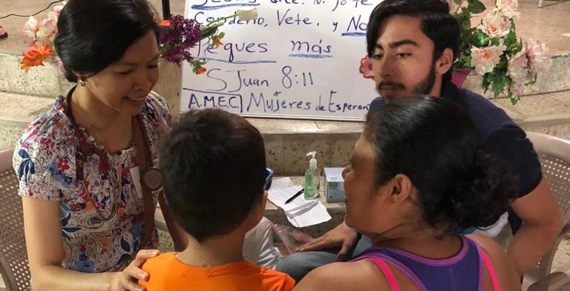

Slide 13
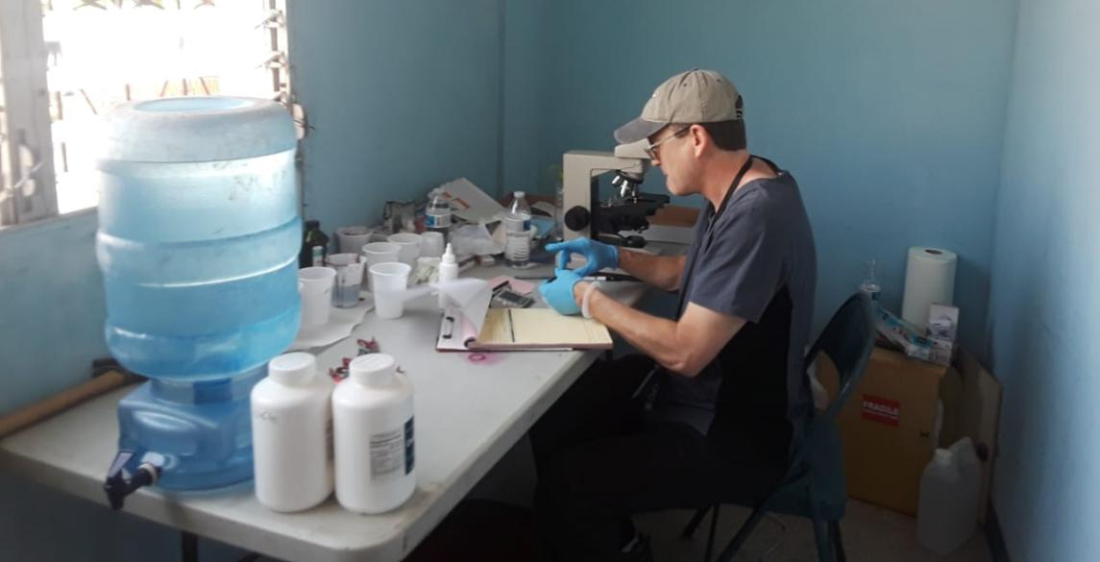

Slide 14
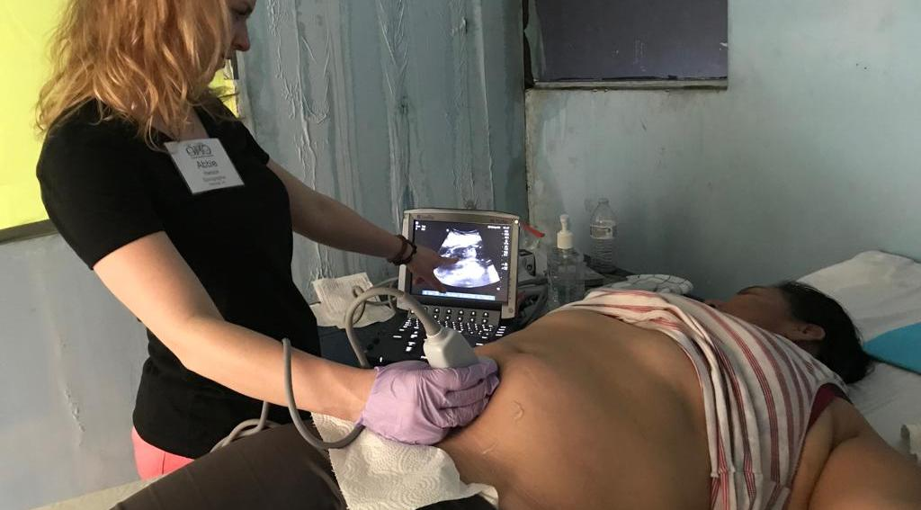

Slide 15
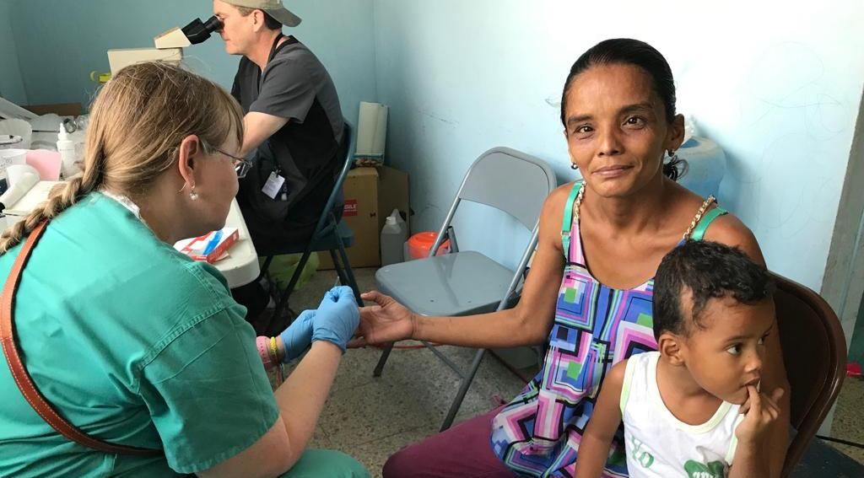

Slide 16
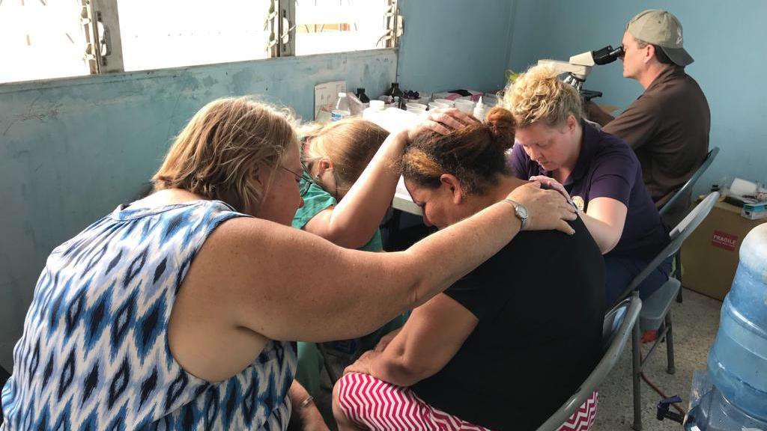

Slide 17
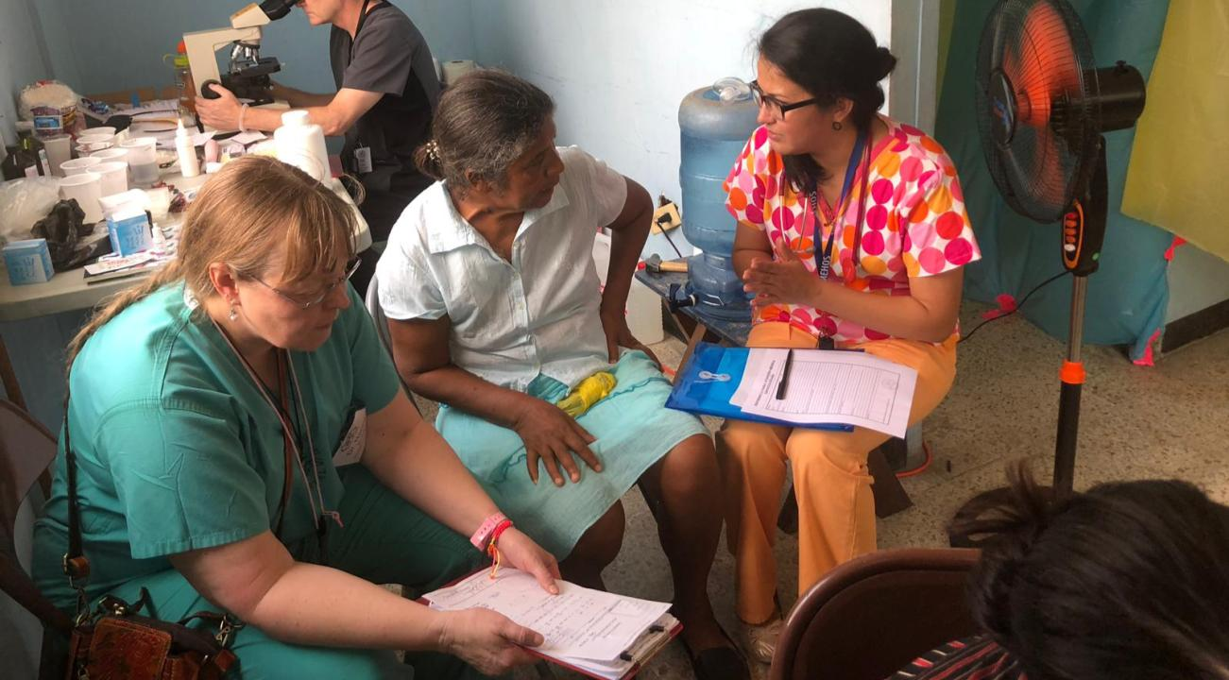

Slide 18
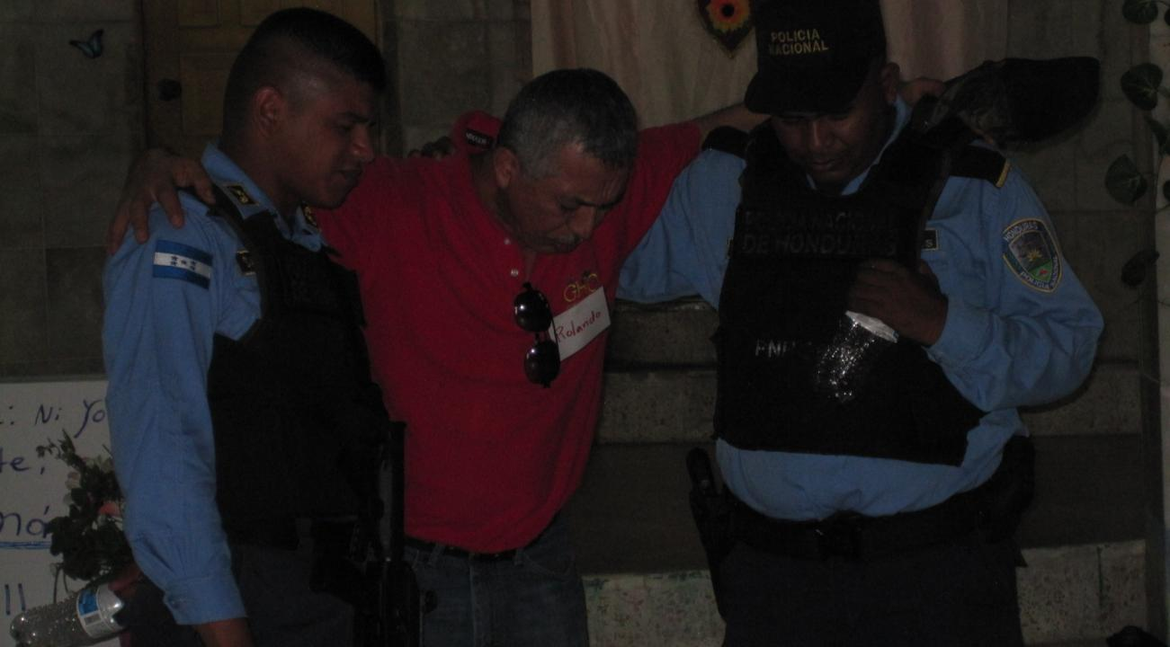

Slide 19
Cruz Nurse’s Aide

Slide 20
Paola 12 yrs Old

Slide 21
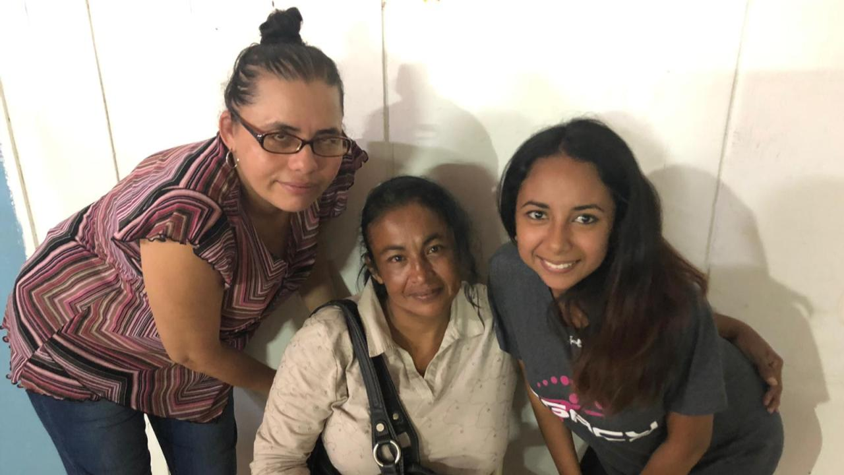

Slide 22
MISSION ACCOMPLISHED! TO GOD BE THE GLORY! 54 New Salvations!
153 Gyn Patients 11 patients DX w/Syphilis; 1 New case of HIV
289 Medical Patients
198 Pediatric patients
64 Ultrasounds performed
14 Procedures (cervical bx, Cryo)
322 Eye examinations
287 Glasses Dispensed.

Slide 23
A NEW BUILDING FOR WOMEN OF HOPE San Pedro Sula, Honduras
A dream for the future

Slide 24
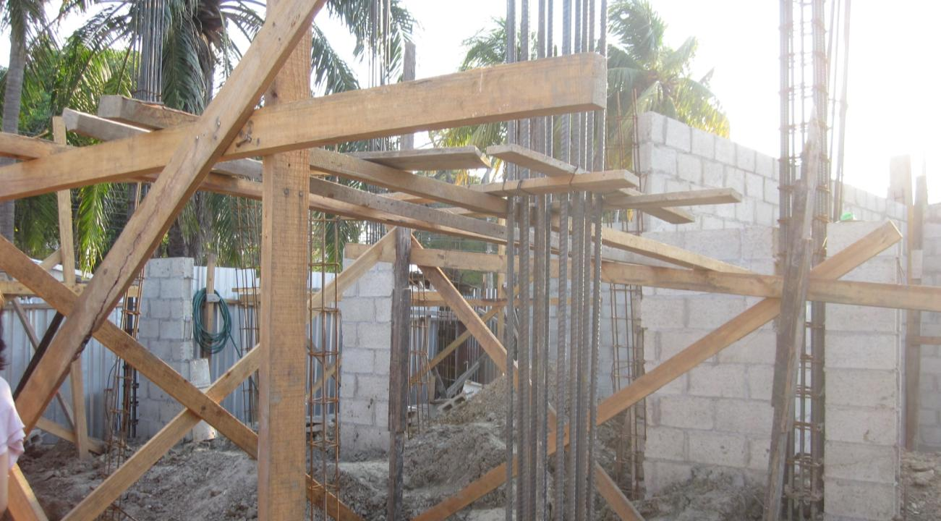

Slide 25
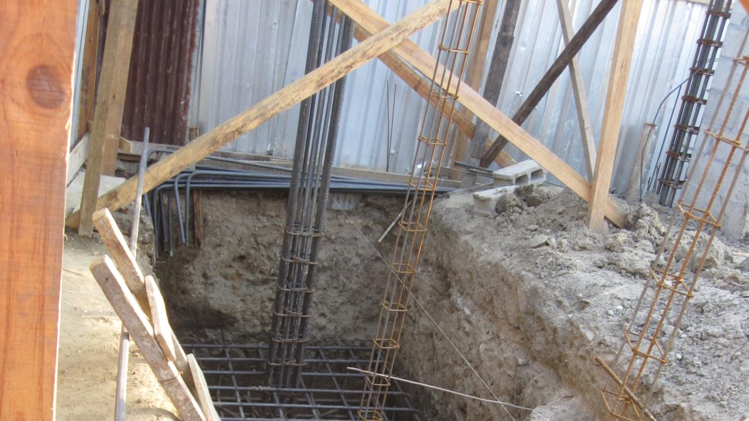

Slide 26
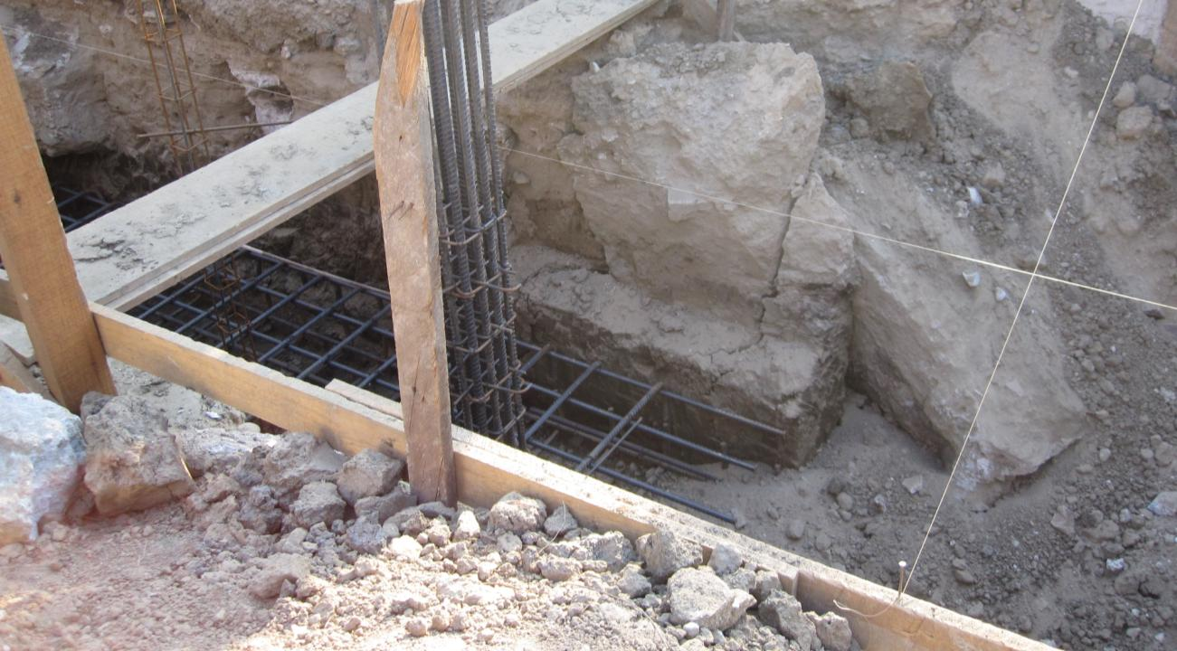

Slide 27
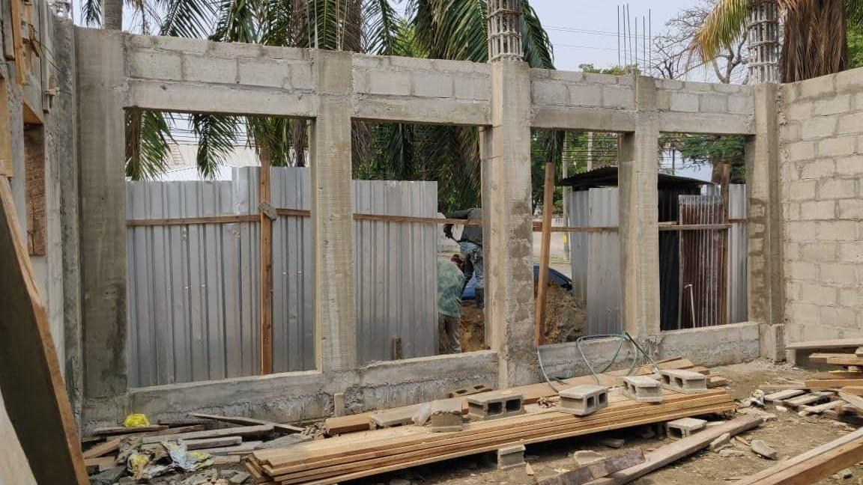

Slide 28
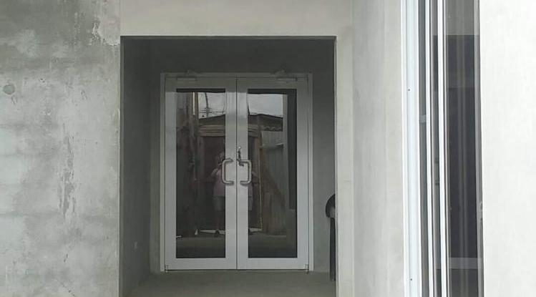

Slide 29
How Can You HELP
1. Pray for the ministry and the women
2. Donate to the Ministry: www.houseofhopeinternational.com and designate your contribution to go to Honduras
3 . Buy some of the products that the women have made at HOH Nicaragua
4. Consider coming on a trip
5. Consider sponsoring a woman/Child In Residence at HOH Nicaragua
6. Consider Donating to the Building Fund for WOH Honduras

